Slide 1

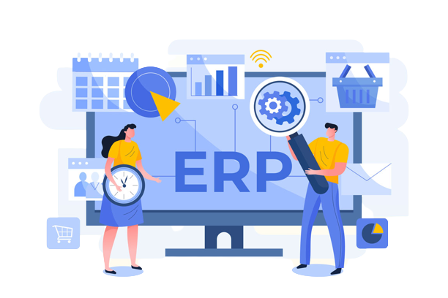
FOSS
Business Solution

Slide 2

Content
ERP
Evolution of ERP
Basic features
Key values of ERP
Open ERP
ERPNext
Modules in ERPNext
Why ERPNext is best
Business scope in ERPNext
Domains in ERPNext

Slide 3

Enterprise Resource Planning(ERP)
Integrated software that organisations use to manage day-to-day business activities such as
HRMS & Payroll
Accounting
Inventory
Project management
Risk management
Compliance
Supply chain operations

Slide 4
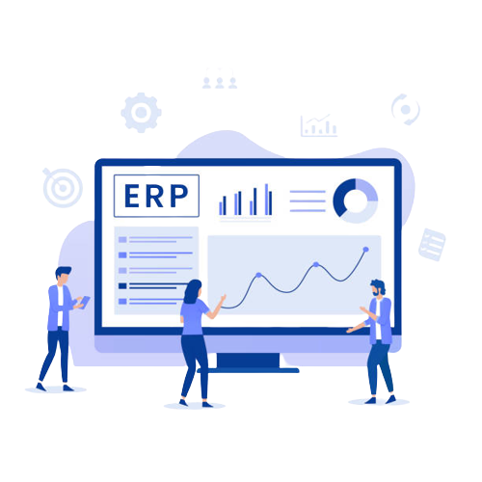
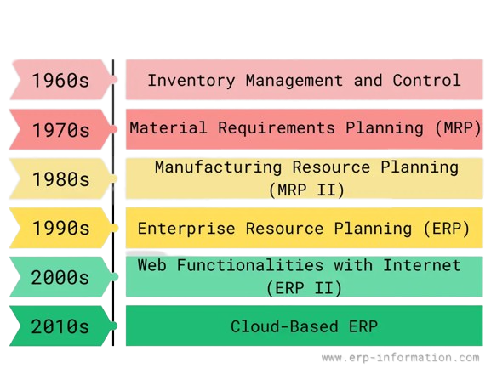
Evolution of ERP

Slide 5
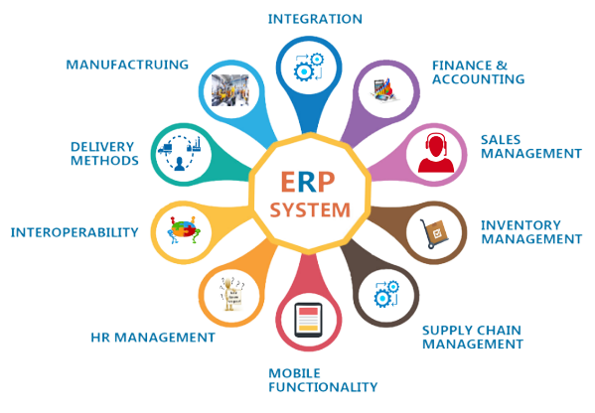
Basic Features of ERP

Slide 6
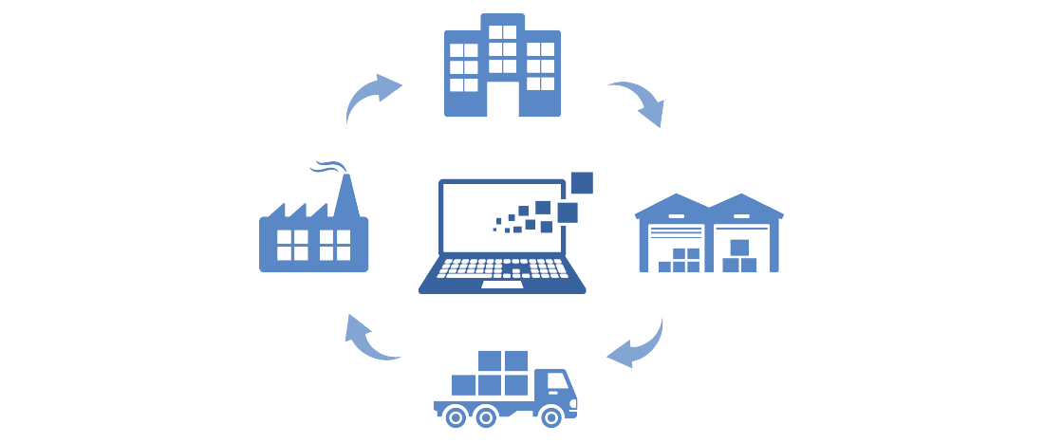
Key values of ERP
Improved company insight
Enhanced collaboration
Improved efficiency
Consistent infrastructure
Reduced risk
Lower management & operational costs

Slide 7


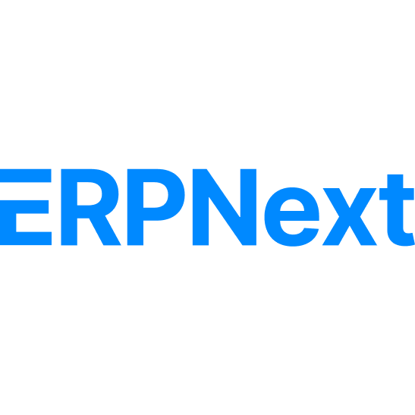




Open ERPs
Open ?
Source code
Can use and customize
Low cost
Customization

Slide 8

ERPNext
Free and open-source integrated ERP software
Rushabh Mehta - Founder of ERPNext(2008)
GNU License.
Developed by Frappe Technologies Pvt. Ltd.
Frappe Framework
Built on MariaDB
Repository - https://github.com/frappe/erpnext

Slide 9
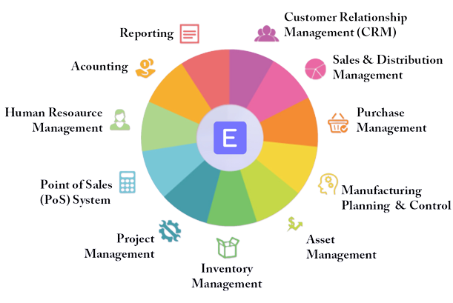
ERPNext Modules

Slide 10

Why ERPNext is the best ?
World's top 100% Open Source ERP
Cloud-Based ERP
Strong security measures
Cost Effectiveness
- Lower Initial Investment
- Extensive Functionality at no additional cost
- Scalability without costly upgrades
- Reduced maintenance and support cost
- Vendor Independence

Slide 11

Why ERPNext is the best ?
Flexibility and customization
- Comprehensive customization options
- User-friendly customization Interface
- Community-Driven Development
- Seamless Integration with Third-party applications
Global Localization and Multilingual support
Continuous development and updates
- Active development community
- Regular updates and new features
- Long-Term support

Slide 12

Business scope in ERPNext
ERPNext implementation services
- Assist organizations in setting up and configuring ERPNext
- Requirement analysis
- System configuration
- Data migration, testing
- User training
ERPNext customization and development
- Customize the software to align with clients’ unique business processes and
requirements
- Custom reports
- Workflows or additional features

Slide 13

Business scope in ERPNext
ERPNext consulting
- Provide expert advice on process optimization
- System integration
- Best practices
ERPNext training and education
- Develop and deliver training programs or workshops to educate individuals and
businesses on how to effectively use ERPNext
- Online courses
- Documentation or conduct instructor-led training sessions to teach ERPNext
- Functionalities and best practices

Slide 14

Business scope in ERPNext
ERPNext support and maintenance
- Resolving technical issues
- Troubleshooting software errors
ERPNext hosting and managed services

Slide 15





Domains in ERPNext
Agriculture
Education
Retail
Healthcare
Manufactoring

Slide 16
Agriculture
The Agriculture module in ERPNext helps you keep track of your farming operations.
Features of Agriculture domain in ERPNext
keep records such as geospatial and soil texture characteristics for each field .
Manage the physical spaces where you plant your crops.
Manage your crops.
Record sale of the harvest or transfer to warehouse for further processing
Track plant, soil, water, weather disease analytics
Record analyzed data.
Helps to plan crop related activities.

Slide 17
Manufacturing
The Manufacturing module in ERPNext covers all necessary features a Manufacturing
business would need.
Complete manufacturing process management
Real-time Inventory management
Quality control
Traceability
Bill of materials (BOM) management
Production planning and scheduling
Cost control
Integration with other business functions

Slide 18
Education
The Education Domain in ERPNext is a feature that helps educational institutions to manage
various aspects of their operations in an integrated and efficient manner
Manage the entire life cycle of a student from :
Admission
Enrollment
Attendance
Assessment

Slide 19
Healthcare
The healthcare Module in ERPNext is used to streamline operations in any healthcare
organization
Manage patient records
Appointments and medical billing
Pharmacy management
Laboratory management
Consultation management

Slide 20
Retail
ERPNext supports retail operations with features:
Point of sale (POS)
Inventory management
Sales tracking
Promotions management
Customer relationship management (CRM)
Retail analytics.

Slide 21
Thankyou

